Slide 1
All Cause Readmission Time for Heart Failure Patients in 2000-2013
Admitted for at least one HF in DX1 between 2000 to 2013
Older than 18 years old
Exclude all patients who ever diagnosed with any cancer in DX1-DX9
5- year look back HF in Dx1-Dx9 history , set as a covariate
Results:
Patient Number= 236,257
No- DX1-9 HF History Patient Number = 136,623

Slide 2
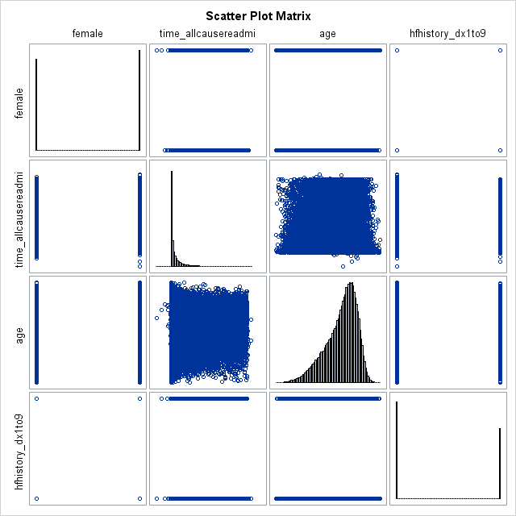

Slide 3
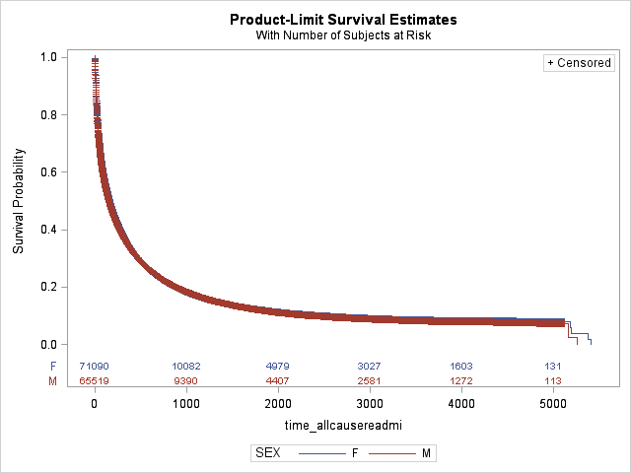
All Cause Readmission / no HF DX1-9 history
Summary of the Number of Censored and Uncensored Values
Stratum | SEX | Total | Failed | Censored | Percent Censored
1 | F | 71090 | 57457 | 13633 | 19.18
2 | M | 65519 | 53445 | 12074 | 18.43
Total |  | 136609 | 110902 | 25707 | 18.82
Test of Equality over Strata
Test | Chi-Square | DF | Pr > Chi-Square
Log-Rank | 13.5909 | 1 | 0.0002
Wilcoxon | 49.9595 | 1 | <.0001
-2Log(LR) | 22.4051 | 1 | <.0001
Notes:
Remove the marks, remove the band
If you die in the same admission of the first hf , then exclude
Start date should be the dischared date

Slide 4
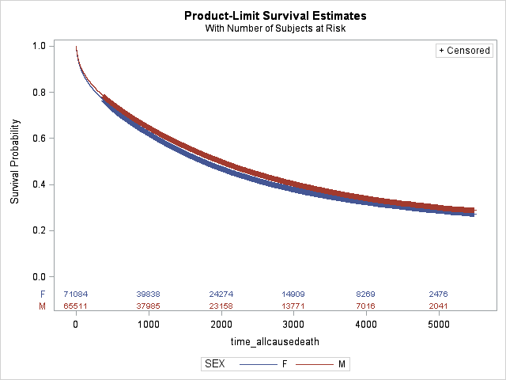
All Cause Mortality/ no HF DX1-9 history
Summary of the Number of Censored and Uncensored Values
Stratum | SEX | Total | Failed | Censored | Percent Censored
1 | F | 71084 | 42198 | 28886 | 40.64
2 | M | 65511 | 36847 | 28664 | 43.75
Total |  | 136595 | 79045 | 57550 | 42.13
Test of Equality over Strata
Test | Chi-Square | DF | Pr > Chi-Square
Log-Rank | 103.2155 | 1 | <.0001
Wilcoxon | 127.3891 | 1 | <.0001
-2Log(LR) | 94.6224 | 1 | <.0001

Slide 5
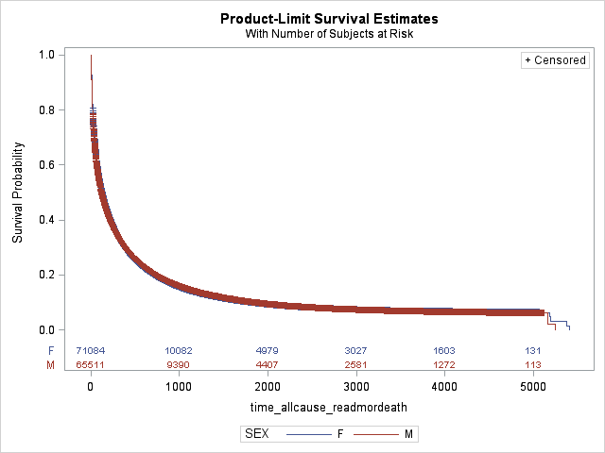
All Cause Readmission or Mortality/ no HF DX1-9 history
Summary of the Number of Censored and Uncensored Values
Stratum | SEX | Total | Failed | Censored | Percent Censored
1 | F | 71084 | 64057 | 7027 | 9.89
2 | M | 65511 | 58785 | 6726 | 10.27
Total |  | 136595 | 122842 | 13753 | 10.07
Test of Equality over Strata
Test | Chi-Square | DF | Pr > Chi-Square
Log-Rank | 2.3651 | 1 | 0.1241
Wilcoxon | 21.2609 | 1 | <.0001
-2Log(LR) | 6.8603 | 1 | 0.0088

Slide 6
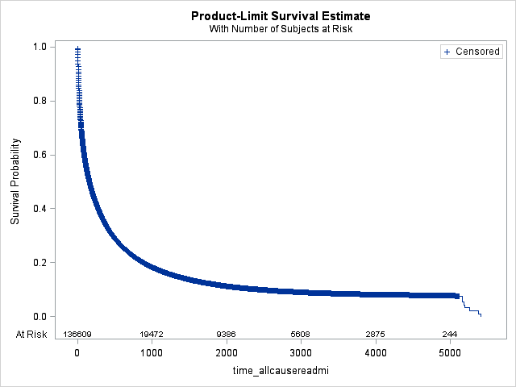
All Cause Readmission / no HF DX1-9 history
Mean | Standard Error
769.09 | 5.20

Slide 7
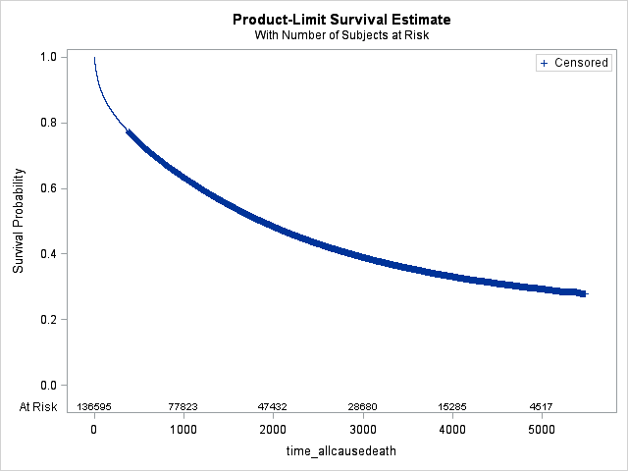
All Cause Mortality/ no HF DX1-9 history
Mean | Standard Error
2530.71 | 6.37

Slide 8
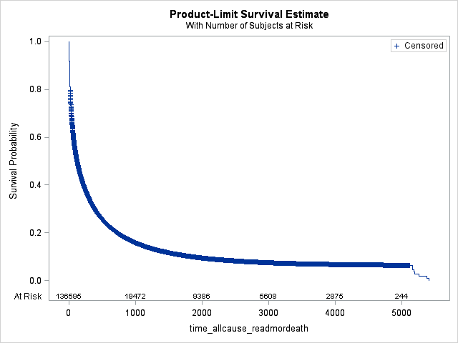
All Cause Readmission or Mortality/ no HF DX1-9 history
Mean | Standard Error
666.23 | 4.47
Notes:
Cox model
Sex gender age race insurance admission_year; LOOK BACK FIVE YEARS FROM THE INDEX ADM_DATE usual susbpect: diabetes; hypertension, CHD, CKD, COPD.

